Slide 1
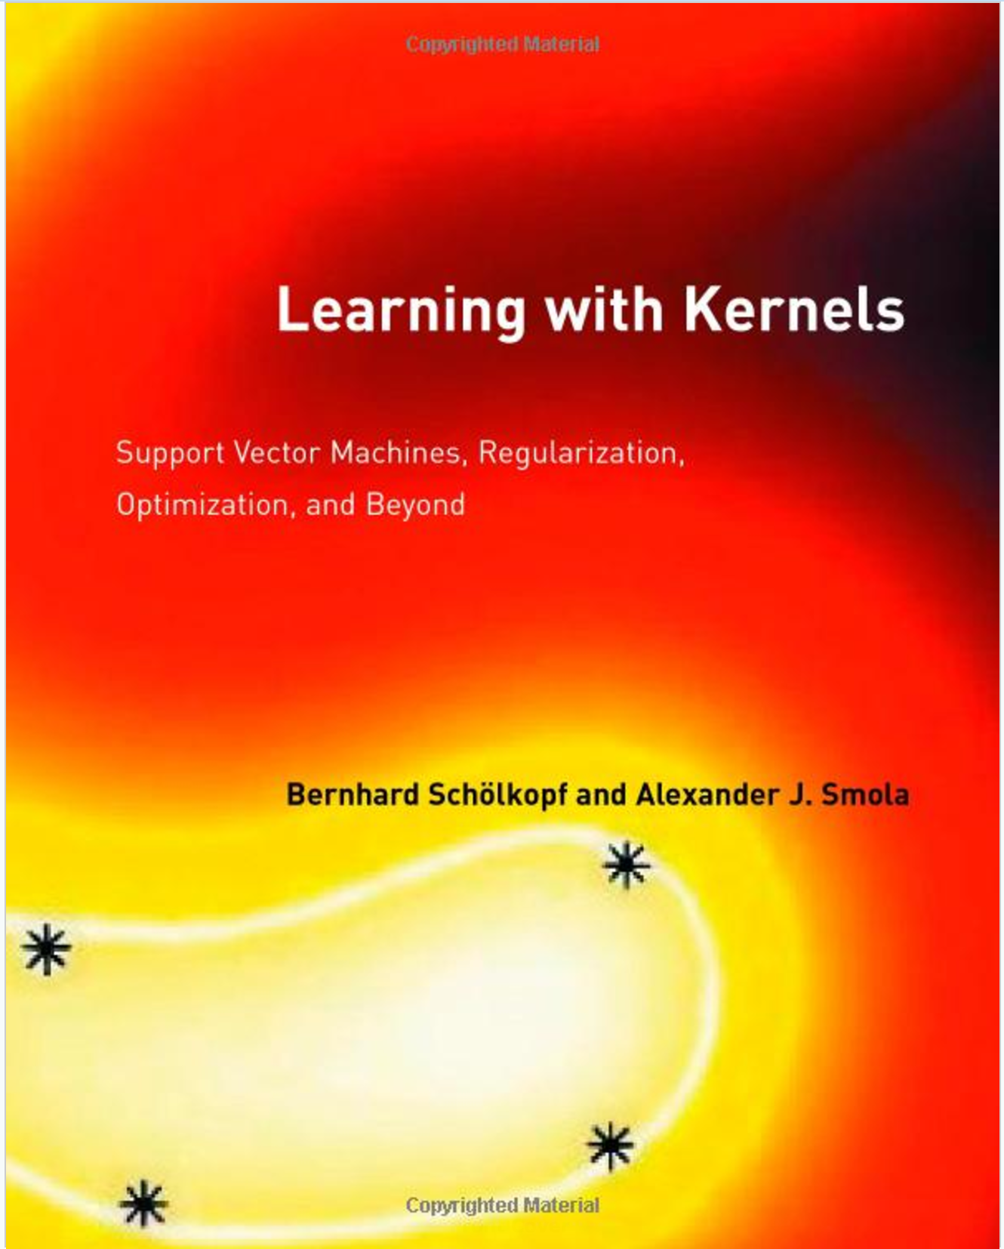
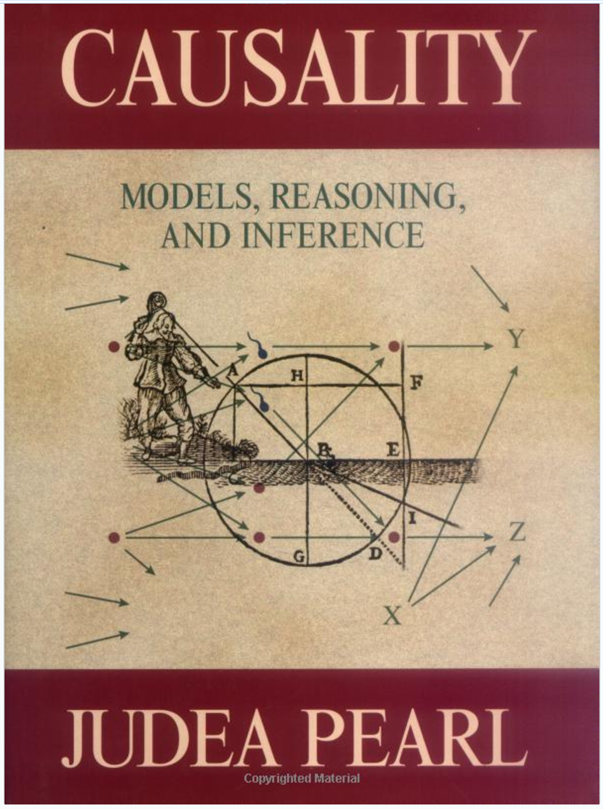
Key Books in ML

Slide 2
Data Mining 2 Supervised Learning
BAYESIAN NETWORKS
Dr. Shailesh Kumar
ISB/CBA

Slide 3
STRUCTURE and CAUSALITY
ONE Variable (COLOR)
ONE Value (RED)
STRUCTURE? CAUSALITY?
ONE Variable (COLOR)
TWO Values (RED, BLUE)
STRUCTURE? CAUSALITY?
TWO Variables (COLOR, LIKE)
COLOR Values (RED, BLUE)
LIKE has ONE Value (YES)
STRUCTURE? CAUSALITY?
TWO Variables (COLOR, LIKE)
COLOR Values (RED, COLOR)
LIKE Values (YES, NO)
STRUCTURE? CAUSALITY?
With only ONE Variable → No CAUSALITY possible
With only ONE Value of a Variable → No STRUCTURE possible
> 1 Variables each taking > 1 values makes life fun!

Slide 4
Bayesian View
ONE Variable (COLOR)
ONE Value (RED)
ONE Variable (COLOR)
TWO Values (RED, BLUE)
TWO Variables (COLOR, LIKE)
COLOR takes (RED, BLUE)
LIKE takes (YES)
TWO Variables (COLOR, LIKE)
COLOR takes (RED, BLUE)
LIKE takes (YES, NO)

Slide 5
Estimating Joint Probability
COMPLEXITY = STRUCTURAL x CAUSALITY
STRUCTURE but NO CAUSALITY
STRUCTURE with MINIMUM CAUSALITY

Slide 6
An experiment in Causality!
LIKE?
SHAPE
SIZE
COLOR
SOUND

Slide 7
Another experiment in Causality!
SEASON
SPRINKLER
RAIN
WET
SLIPPERY

Slide 8
Another experiment in Causality!
SEASON
SPRINKLER
RAIN
WET
SLIPPERY

Slide 9
Another experiment in Causality!
SEASON
SPRINKLER
RAIN
WET
SLIPPERY

Slide 10
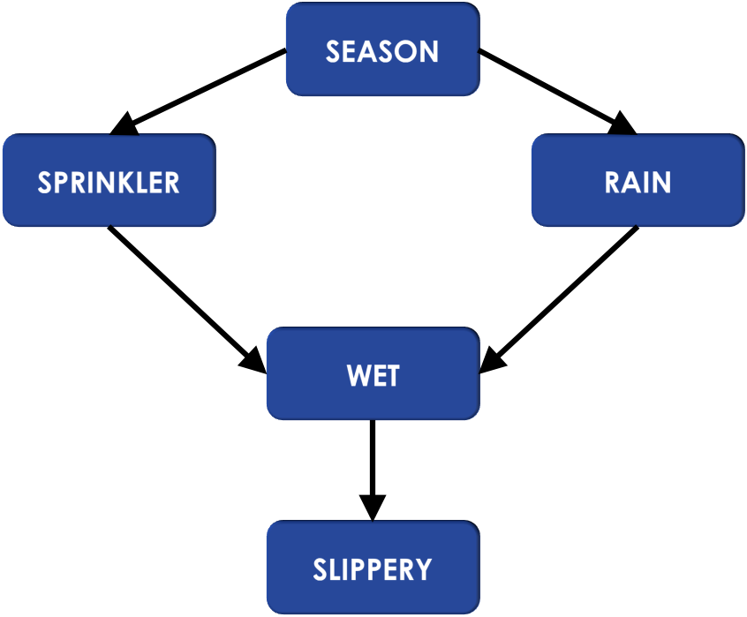
Bayesian Networks
STRUCTURE: More than one value per variable!!!
CAUSALITY:
More than one variable
Some variables CAUSE values of others
CAUSAL PARENTS
Variables that Cause a Variable

Slide 11
Bayesian Networks Equation

Slide 12
Simplest Causality Structure!
LIKE?
SHAPE
SIZE
COLOR
SOUND

Slide 13
Parameters in this Model
SEASON
SPRINKLER
RAIN
WET
SLIPPERY

Slide 14
Parameters in this Model
SEASON
SPRINKLER
RAIN
WET
SLIPPERY

Slide 15
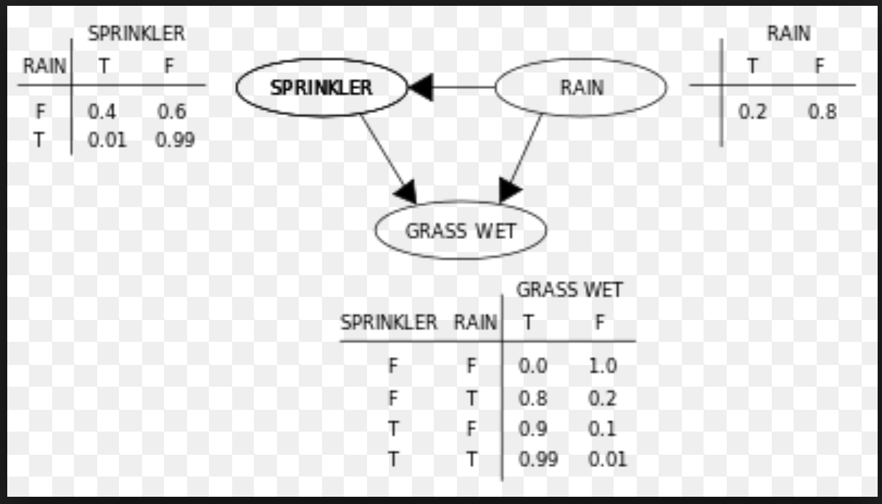
Inferencing Class from data

Slide 16
Computing any joint

Slide 17
Lessons
Correlation is NOT Causality
Imperfect Classification due to?
Noise in Data
Noise in Labels
Insufficient Complexity of Model
Insufficient Training Data
Not all features affecting cause are known
Proper Causality structure not known

